Slide 1
Yumi in my Tumi
Digital Crafts 2023
Project 1

Slide 2
Yumi in my Tumi
Step 1
Building the Foundation
This phase will consist of building the basics
1. Html
-Designing the Basics of the home page and it’s children
2. BootStrap
-Designing a windowed sidebar to help navigate to different
sections of the app
3. JavaScript
-Coding the fundamentals of both API’s making sure they are
functional, so we can push it in Step 5
Step 2
HOME SCREEN
Step 3
Search Bar This phase will be creating a search bar using the API
1. Using the Scene it as reference, we will create a search bar by
-Adding a submit form
-”Fetching” the data from the API and await response from JSON
-Then formatting the data we received into recipes that can take
the user to that section
Step 4
Favorites
Creating a different section that users can store recipes to create or view later
1. Creating a function, ‘saveToFavorites’
-setting the FavList to NULL
-We can save each Recipe in a ‘let’ variable
-Saving each variable into Local Storage
- Then pull it from Local Storage to access it
Step 5
Analyzing my Ingredients AND Recipe Search
This section will call both API’s
1. Using fetch to gather data from each API
2. Referencing the Render Movies function
3. Using DOM to load the content into the specific format
The home screen consists of three major sections
1. Home page
-Holds the Favorites, Analyzing Ingredients, About Us sections
2. Favorites
-Users can save recipes
3. Analyzing my Ingredients
-User enter food amount, and returns the Nutrition Facts

Slide 3
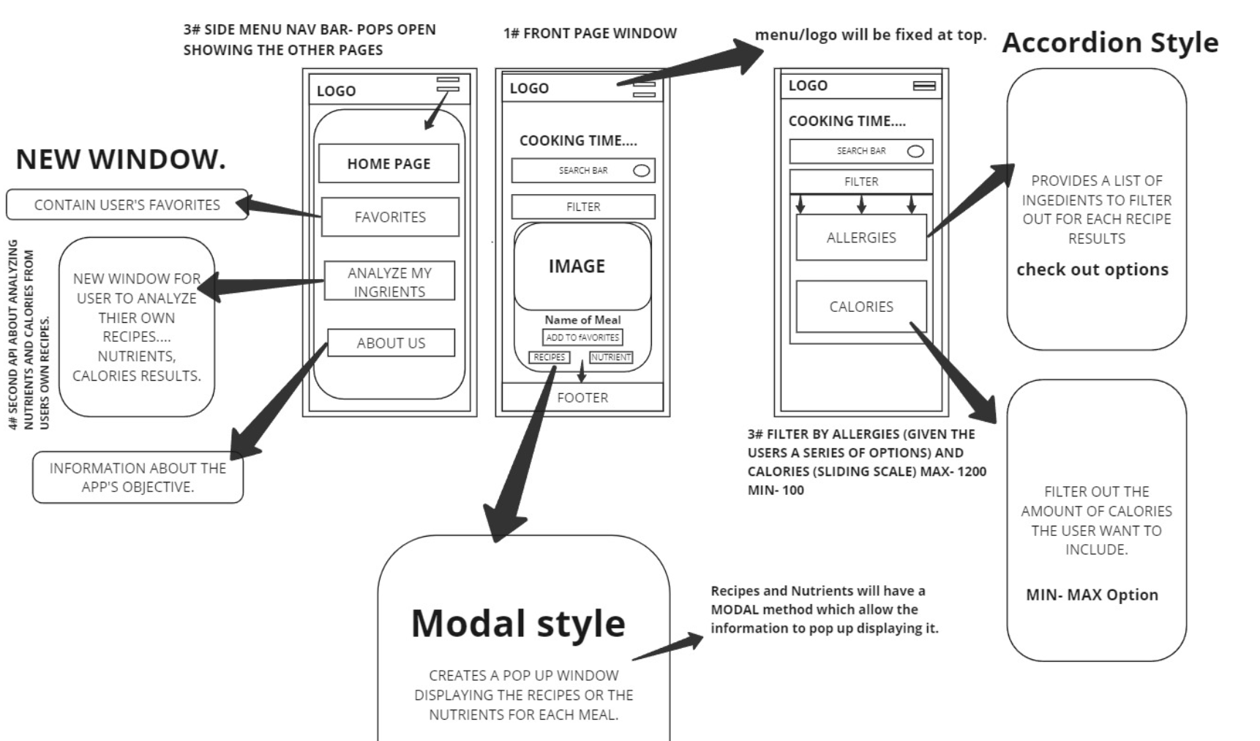
Building the Foundation
This phase will consist of building the basics
1. Html
-Designing the Basics of the home page and its children
2. BootStrap
-Designing a windowed sidebar to help navigate to different
sections of the app
3. JavaScript
-Coding the fundamentals of both API’s making sure they are
functional, so we can push it in Step 5
Notes:
This is only the basics

Slide 4
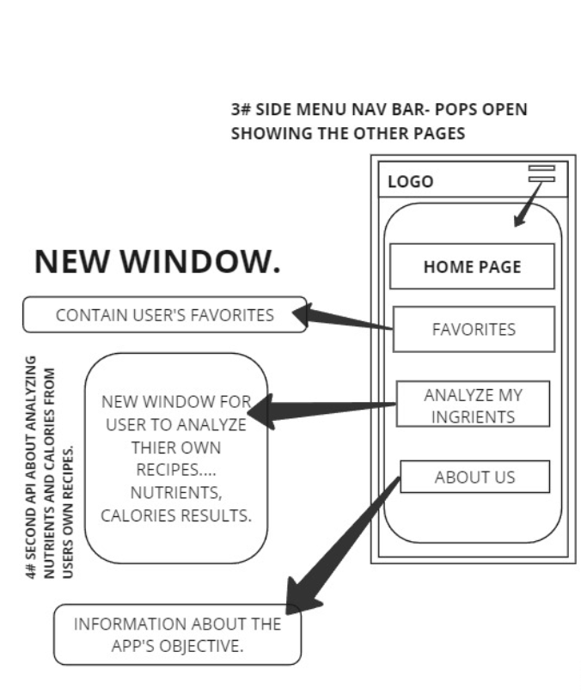
Home Screen
The home screen consists of three major sections
1. Home page
-Holds the Favorites, Analyzing Ingredients, About Us sections
2. Favorites
-Users can save recipes
3. Analyzing my Ingredients
-User enter food amount, and returns the Nutrition Facts
Notes:
The home page will consists of three sections:
Favorites- where users can save recipes
Home page – going back to the main menu
Analyzing ingredients where users can enter in an amount of what ever food, and returns an exact nutrition fact page. TO see if you are over or under your calorie limit or under your carb intake

Slide 5
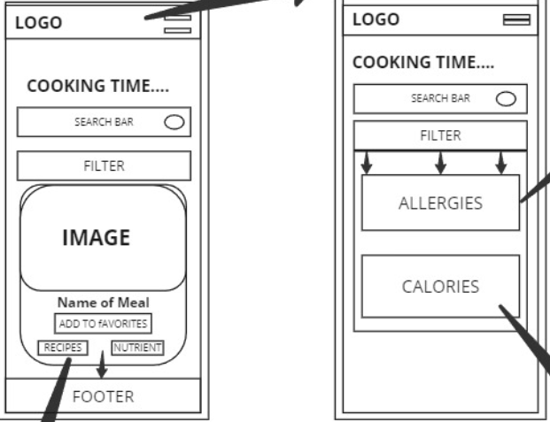
Search Bar
This phase will be creating a search bar using the API
1. Using the Scene it as reference, we will create a search bar by
-Adding a submit form
-”Fetching” the data from the API and await response from JSON
-Then formatting the data we received into recipes that can take
the user to that section

Slide 6
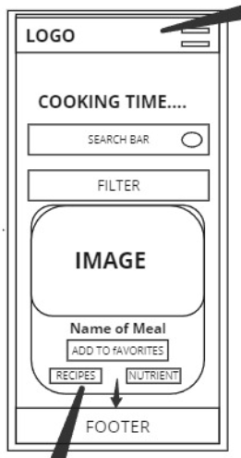
Favorites
Creating a different section that users can store recipes to create or view later
1. Creating a function, ‘saveToFavorites’
-setting the FavList to NULL
-We can save each Recipe in a ‘let’ variable
-Saving each variable into Local Storage
- Then pull it from Local Storage to access it
Notes:
Favorites section the user will be able to see the recipes and the instructions of them

Slide 7
Analyzing Ingredients and Recipe List
This section will call both API’s
1. Using fetch to gather data from each API
2. Referencing the Render Movies function
3. Using DOM to load the content into the specific format

Slide 8




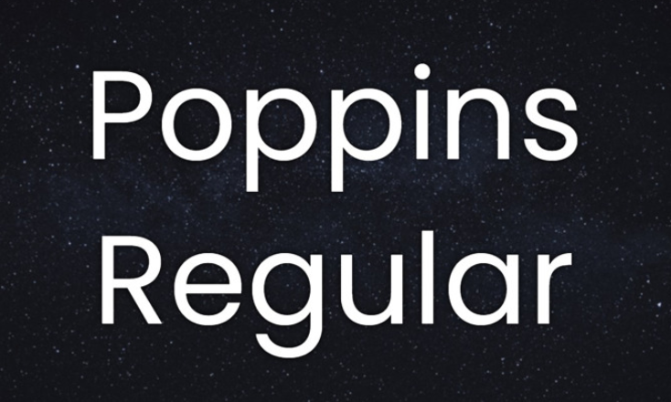
STYLING
COLOR
#99C63D
#729D50
#CDE49F
#B78D60
#FFFFFF
FONT: POPPINS

